Slide 1

Web Scraping Gathering Data from Websites
Submitted By
190050107 P R V S SIDDHARDHA
190050045 Ravi Shankar Palle

Slide 2
Web Scraping - What We’ll Cover
Build a data corpus of congressional press releases
APIs and gather latitude and longitude -- using JSON formatted data
A brief hands-on introduction into HTML parsing
APIs and Documentation (FTP) -- OpenSecrets.org
Discussion of APIs and Social Media data gathering
A brief discussion on the ethics of scraping

Slide 3
This is not a programming workshop, but...
We will discuss Python and BeautifulSoup
We will not learn or use Python in the workshop
However, some automation tools are used in this workshop
Web Scraping is about deconstructing websites. Effective scraping requires learning about technical infrastructure as well as subject content
Not a workshop on Text Analysis (tools that calculate or correlate your data)
Not a workshop on data cleaning

Slide 4
Technical Definitions Deconstruction v Construction

Slide 5
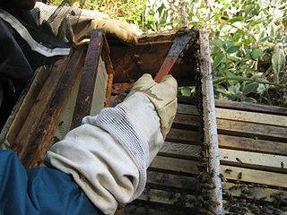
Definitions
Scraping Using tools to gather data you can see on a webpage A wide range of web scraping techniques and tools exist. These can be as simple as copy/paste and increase in complexity to automation tools, HTML parsing, APIs and programming
Scraping propolis from the sides of the bee box
Image by Abalg~commonswiki

Slide 6
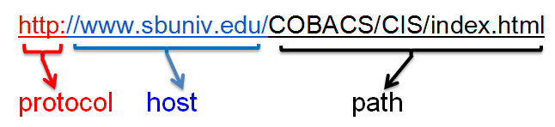

Definitions
Scraping
HTTP HyperText Transfer Protocol Machine interchange information transported over the Internet to enable multi-media data exchange, aka WWW. The protocol defines aspects of authentication, requests, status codes, persistent connections, client/server request/response. etc. Access a server on port 80; the declarative Document Type Definition ( HTML, XML, JSON, etc.)
Images from commons.WikiMedia.org

Slide 7

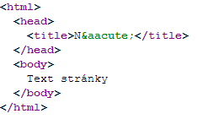
Definitions
Scraping
HTTP
HTML HyperText Markup Language The standard markup language on the Web As the web evolves so does the proliferation of technical wrappers surrounding the visible content of websites (text and data)
Image by Jesper Rønn-Jensen
Image by Michaelbrabec

Slide 8
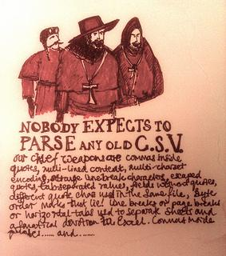
Definitions
Scraping
HTTP
HTML
Parsing The act of analyzing the strings and symbols to reveal only the data you need
Image by Paul Downey

Slide 9

Definitions
Scraping
HTTP
HTML
Parsing
Crawling Moving across or through a website in an attempt to gather data from more than one URL or page
Image by Dave Gingrich

Slide 10
Definitions
{ "firstName": "John", "lastName": "Smith", "isAlive": true, "age": 25, "address": { "streetAddress": "21 2nd Street", "city": "New York", "state": "NY", "postalCode": "10021-3100" }, "phoneNumbers": [ { "type": "home", "number": "212 555-1234" }, { "type": "office", "number": "646 555-4567" } ], "children": [], "spouse": null }
Scraping
HTTP
HTML
Parsing
Crawling
JSON Javascript Open Notation Readable text used to transmit data objects consisting of attribute-value pairs -- Wikipedia

Slide 11

Definitions
Scraping
HTTP
HTML
Parsing
JSON
Crawling
API Application Programming Interface
A set of rules and protocols used to build a software application. In the context of Web Scraping an API is a method used to gather clean data from a website (i.e. data that is not wrapped in HTML, Javascript, bound in HTTP, etc.)
Image by Tsahi Levent-Levi

Slide 12
Webscraper.io Demonstration & Hands-on

Slide 13
Demo: Scraping Congressional Press Releases
Representative Nancy Pelosi’s Press Releases
CONTENT
Structure of the Press Release subsection of the site
Pagination
Links to each release
Common elements of release
TOOLS
Webscraper.io tool works inside of Chrome
Tutorials
Documentation
Community
Free or, alternatively, Fee for Service

Slide 14
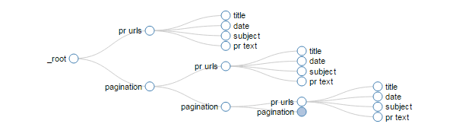

Slide 15
Now You Try It
http://v.gd/webscraping1111
Follow the download & installation instructions: step 9a
Find some congressional press release sites: step 9b
Follow the instructions: steps 1-8

Slide 16
Google Sheets
Demonstration
ImportHTML
ImportXML

Slide 17
Google Sheets -- ImportHTML
Example Site: http://www.boxofficemojo.com/
IMPORTHTML(url, query, index)
In Practice:
=IMPORTHTML("http://www.boxofficemojo.com/","table",3)
http://www.boxofficemojo.com/movies/?page=intl&id=annie2014.htm
=IMPORTHTML(A6,"table",6)
Help Docs: https://support.google.com/docs/answer/3093339?hl=en

Slide 18
Google Sheets -- ImportXML
Example Site: http://www.nytimes.com/
IMPORTXML(url, xpath_query)
In Practice:
=IMPORTXML("http://nytimes.com/", "//*/p[contains(@class, 'summary')]")
Help Docs: https://support.google.com/docs/answer/3093342?hl=en

Slide 19
Resources
YouTube Videos
Web Scraping with Google Sheets
Importing Data 4 ImportXML
Web scraping using Google Docs - Xpath
Other Resources
CSS Tutorial
XPath
XPath Language defined by W3C
Your Turn:
https://github.com/data-and-visualization/Rfun

Slide 20
APIs, Parsing, & JSON

Slide 21
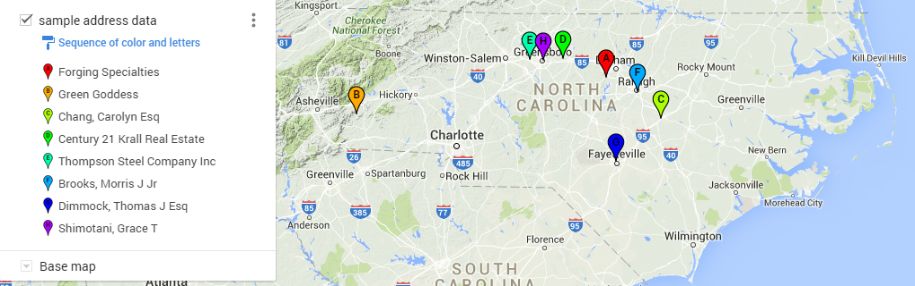
OpenRefine & JSON file format
Demonstration (http://v.gd/parsing3333)
A step-by-step guide using OpenRefine to gather JSON data via Google Map’s API; then parse the JSON for latitude & longitude

Slide 22
Parsing HTML

Slide 23
OpenRefine & ParseHtml
BeautifulSoup Libraries
Refine uses the Jython Libraries and has Jsoup
jSoup is a Java library built on BeautifulSoup -- a tool for HTML Extraction
Resources (OpenRefine)
Step-by-step example documented in the demonstration above
Documentation
Refine’s documentation on HTML Parsing
jSoup Documentation
Now You Try it -- http://v.gd/parsing2222

Slide 24
Case Study: OpenSecrets and documentation

Slide 25
OpenSecrets API and FTP
OpenSecrets tracks the effects of money and lobbying in elections and politics
OpenSecrets has an API
OpenSecrets API Documentation
OpenSecrets Bulk Data downloader
Login
Lobby.zip
Notes:
The main point of this slide highlights that making data available via [public] APIs is an evolving trend. There are older standards, like FTP, which still facilitate the release of information and clean data. Sometimes the data are right under your nose if you simply read the available documentation. In this example, the APIs and webpages do not support a basic data need, but the Bulk Downloader -- once registered and logged in -- does make data available in a needed format/configuration.
https://www.opensecrets.org/resources/create/data.php

Slide 26
Social Media

Slide 27
Social Media
Many ways to gather social media data
IFTTT where you compose rules to connect sites and can deposit data in a spreadsheet
APIs - often requires registered keys
Buy your data from a service such as GNIP
After you download it you may want to perform analysis
Sentiment Analysis, Word Frequency, Correlation, etc.
Text Analysis tools (from Digital Humanities LibGuide)
Digital Studio’s program on working with Texts: Comparing and choosing texts analysis tools

Slide 28
TAGS: a tool for collecting Twitter streams
TAGS (“New Sheets”; Version 6.0ns) - https://tags.hawksey.info/
Form driven (not command line)
Minimal setup
Data are collected in Google Sheets
Gather twitter stream data by type
screen-name stream data
screen-name status updates
twitter user favorited tweets
Search term for last 7 days: hashtag stream, username, boolean logic
Limit by date
Schedule to run hourly - set your interval, or run once.
3 minute setup-video; easy to use - https://youtu.be/Vm0kjAvH5HM
Outputs: raw CSV structured data, plus default social graph visualizations

Slide 29
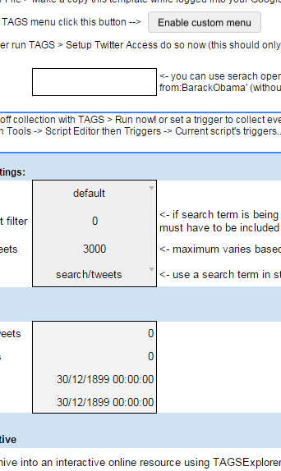

Slide 30
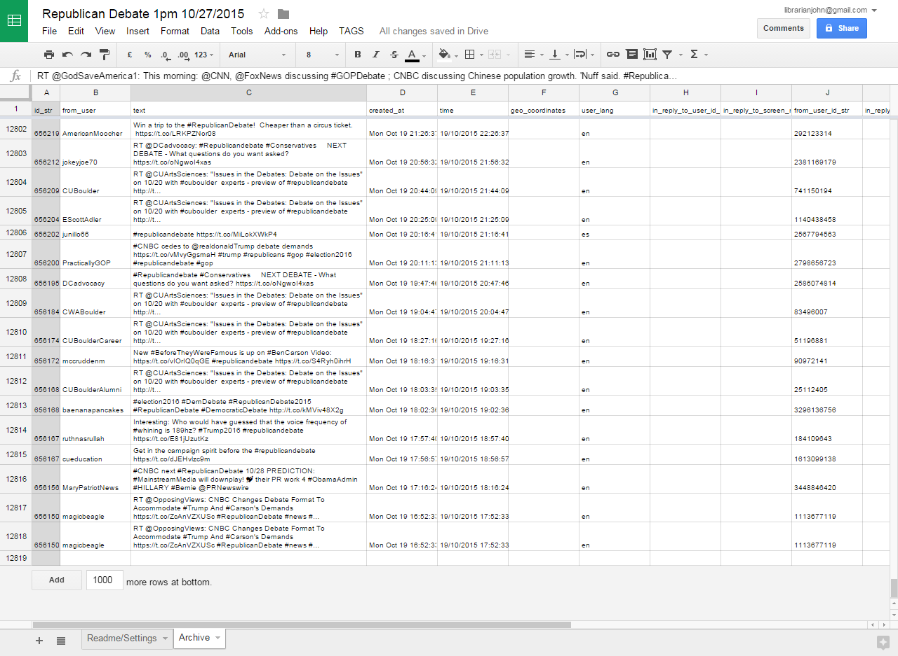

Slide 31
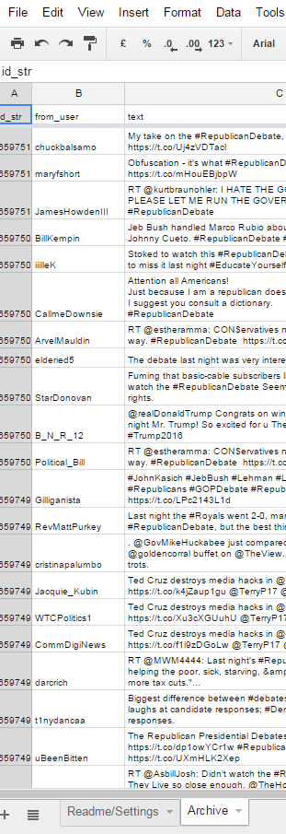
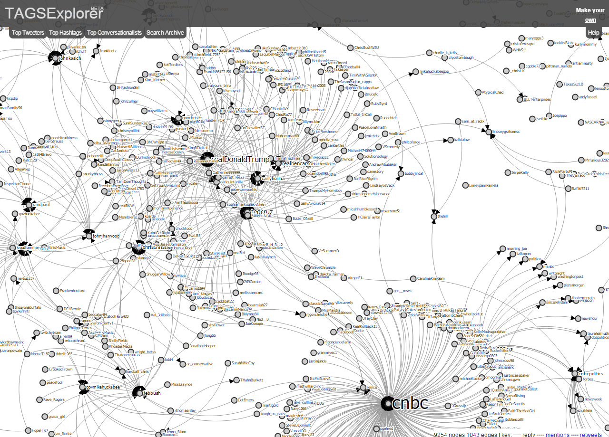

Slide 32
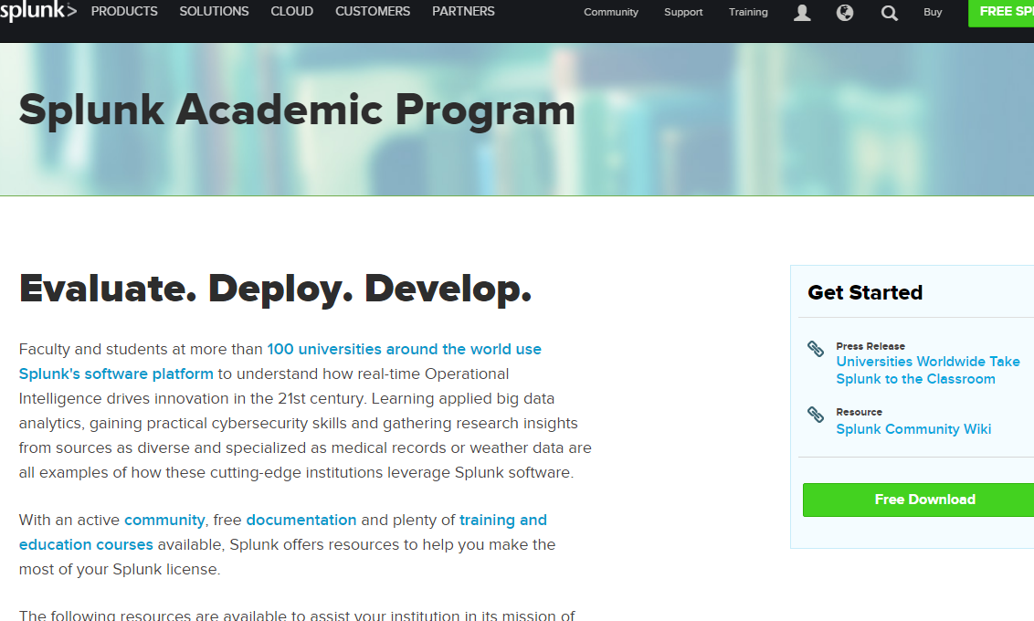
Splunk Academic Program
https://www.splunk.com/en_us/solutions/industries/higher-education/academic-licenses.html

Slide 33
Ethics

Slide 34
Ethics & Technical Challenges of Web Scraping
Like copyright, there are rules, protocols, and best practices
Do you identify yourself?
Do you document your downloading steps?
Do you document your analysis steps?
Is your research reproducible?
Are your methods and processes confidential or proprietary?
How do you protect and document your sources?
How do you give credit to your sources?
Articles:
To Scrape or Not to Scrape: Technical and Ethical Challenges of Collecting Data off the Web
On the ethics of web scraping from a data journalism perspective

Slide 35
Resources
Catalog of Web Scraping tools https://docs.google.com/spreadsheets/d/1A_9wBEmc8VP6HUm2R-7jdPU9FWY8dSfNsfIjQ6cz638/edit#gid=0
Tools used or demonstrated in this Workshop
Webscraper.io - http://webscraper.io/ (script and crawl a website)
OpenRefine - http://openrefine.org (scripting, cleaning, parsing, utility data tool)
Regular Expressions
GREL
Jsoup
TAGS - https://tags.hawksey.info/ (Twitter Stream collector)
Splunk - Academic Program (Twitter Stream collector / Search and Discover )
Ethics
To Scrape or Not to Scrape: Technical and Ethical Challenges of Collecting Data off the Web
http://gijn.org/2015/08/12/on-the-ethics-of-web-scraping-and-data-journalism/

Slide 36
Thank You!

